Slide 1
The Impacts of COVID 19 on Student's Academic
Darius White
Emerging Issues in Education
10/23/2020

Slide 2
The Health and Wellness Impact of COVID-19 on Student’s Academic
COVID-19 has contributed to psychological issues among students
Student’s mental health has been affected.
Disruption of student’s routines has led to stress.
Notes:
The current situation of the COVID-19 pandemic has led to psychological issues affecting the students and public health. Research assessing the mental health implications of COVID-19 to the general public has shown drastic effects on students. The spread of outbreaks has resulted to health problems. Further research is needed to show how COVID-19 has disrupted the lives and routines of students, affecting student’s psychological and mental impacts.

Slide 3
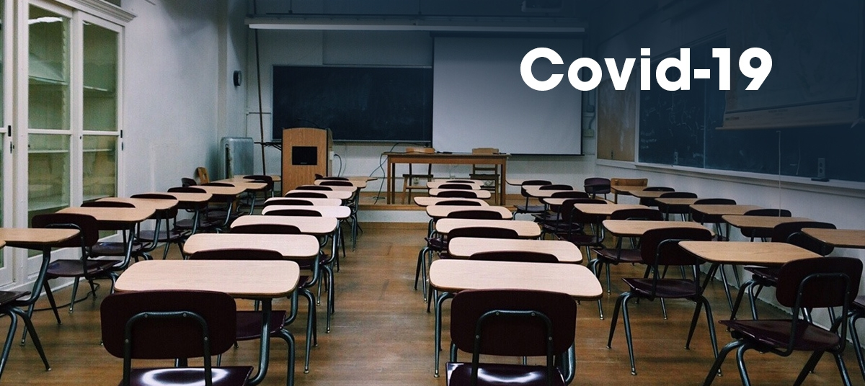
Effects of Student’s Health on Performance
COVID-19 has caused psychological stress.
Implementation of online learning as the means of study has affected student performance
Lack of motivation from teachers.
Notes:
COVID-19 has led to increase of levels of psychological distress therefore affecting academic consequences negatively. The social distancing measures have been implemented shifting education to online learning(Masonbrink & Hurley 2020). Online learning has led to academic stress for many students affecting their performance. Academic disruption on students has led to reduced motivation for students towards their studies. Many students are not used to learn independently without the guidance and supervisions of the teachers. Lack of motivation has led to high dropout rates due to change of daily routines.

Slide 4
Risk factors for increased transition of COVID-19 in school setting
Transition back schools risks spread of COVID-19.
Lack of nursing services in schools.
Inadequate school facilities
Notes:
School reopening around the world means opportunity for COVID-19 transmission among students and teachers therefore spreading to the general community. The socialization part in school setting is an important factor. Lack of adequate facilities and small size of schools increases the chances of spread of COVID-19. Lack of coordinated strategies by the school’s administration to deal with cases of covid-19 among the students and teachers. Lack of immediate response to covid-19 leading to spread. Many of the schools do not have nurses or health care facilities to cater for students diagnosed with COVID-19.

Slide 5
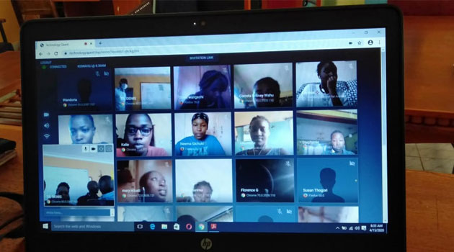
Gap affiliated with covid-19 and inequality among students
Virtual online has contributed to inequality among students.
Students live in different set of environment causing insecurity.
Students from the vulnerable communities are the most affected(Azevedo et al. 2020).
Notes:
Closure of the schools has transformed education to virtual classrooms highlighting inequalities since all students cannot afford same virtual classroom setting and others can’t join the virtual learning. Virtual learning does not increase inclusivity among the students. The students from public schools are the mostly affected by the closure since most were not subjected to virtual learning before. The closure of schools has exposed the gap which exists in the education system. Students are conscious about the environment they stay. The physical space of school creates an equal equation for all the students. Lack of reliable internet for all students affects students in joining of virtual classes. Transition to online cleaning has impacted students from the vulnerable communities.

Slide 6
Reflection Questions
How will COVID-19 have an everlasting impact on the education system?
What should schools do in order to deal with any future pandemics.
What measures have been taken to ensure safe reopening of schools.

Slide 7
References
Azevedo, J. P., Hasan, A., Goldemberg, D., Iqbal, S. A., & Geven, K. (2020). Simulating the potential impacts of covid-19 school closures on schooling and learning outcomes: A set of global estimates.
Masonbrink, A. R., & Hurley, E. (2020). Advocating for children during the COVID-19 school closures. Pediatrics, 146(3).
Nelson, J. L., Palonsky, S. B., & McCarthy, M. R. (2017). Critical issues in education: Dialogues and dialectics. Waveland Press.

